Slide 1
Ensemble Techniques and Model Tuning
Nick Lutostanski AI/ML for Business Applications
2.27.24

Slide 2
Contents / Agenda
Executive Summary
Business Problem Overview and Solution Approach
EDA Results
Data Preprocessing
Model performance summary for hyperparameter tuning.
Appendix

Slide 3
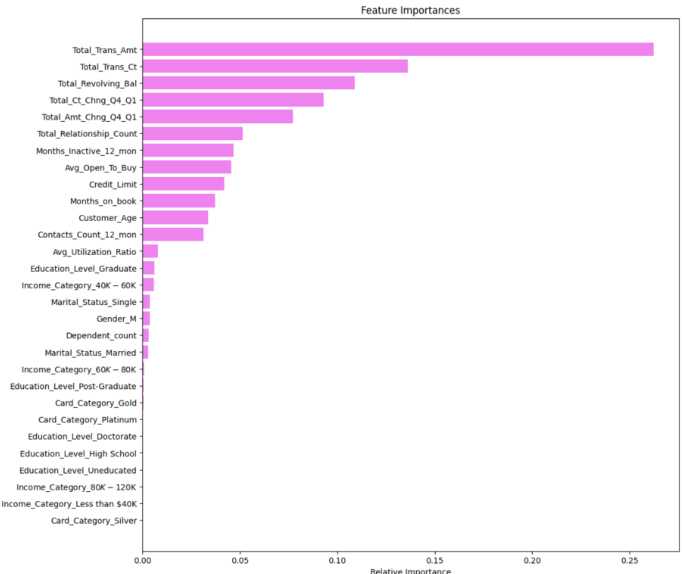
Executive Summary
We built a predictive model that will help the bank predict whether or not a customer is likely to churn (cancel their card). We chose the Adaboost method with undersampled data as the best-performing model.
We found that the most important features to predict whether or not a customer will churn are the total annual spend, total annual transactions, and total revolving balance.
Looking a the bivariate data, most of the customers who cancelled their credit cards with the bank had a total annual spend of about $4,000 per year.
Customers with less than about 75 transactions a year are predicted to churn.
75% of the customers that churned have a total revolving account balance of less than $1500.
Using these insights, we can target promotions towards these customers to incentivize them to use their cards more, which we would predict would keep them as credit card customers. A 0% interest window targeted to these customers might be considered to increase usage in both annual transactions, annual spend, and total revolving balance, which would increase the bank’s ability to retain customers.
Customers with lower % credit utilization are more likely to churn. They may be less likely to use credit and use cash as an alternative. Promotion consideration might be targeted to these customers as well to reduce likelihood of churn.

Slide 4
Business Problem Overview and Solution Approach
The Thera bank recently saw a steep decline in the number of users of their credit cards. Credit cards are a good source of income for banks because of the different kinds of fees charged by the banks; annual fees, balance transfer fees, and cash advance fees, late payment fees, foreign transaction fees, and others. Some fees are charged to every user irrespective of usage, while others are charged under specified circumstances.
Customers’ leaving credit card services would lead the bank to lose revenue, so the bank wants to analyze the data of customers and identify the customers who will leave their credit card services and why– so that the bank could improve upon those areas
You as a Data Scientist at Thera Bank need to come up with a classification model that will help the bank improve its services so that customers do not cancel their credit cards.
We are going to build 5 models (decision tree, bagging, Adaboost, Gradient Boosting, and random forest) using the original data, oversampled data, and under-sampled data.
We are then going to pick 3 of these models and use hyperparameters to tune the performance using GridSearchCV to find optimal values for the hyperparameters.
From there we will pick the best-performing model and present business insights and recommendations.
The model criterion of importance will be the Recall score. The greater the recall score, the higher the chances of minimizing false negatives. This is so that the bank has the highest chance of identifying the true positives(i.e. Class 1) so that the bank can retain their valuable customers by identifying the customers who are at risk of churn.

Slide 5
EDA Results
Features
CLIENTNUM: Client number. Unique identifier for the customer holding the account
Attrition_Flag: Internal event (customer activity) variable - if the account is closed then "Attrited Customer" else "Existing Customer"
Customer_Age: Age in Years
Gender: Gender of the account holder
Dependent_count: Number of dependents
Education_Level: Educational Qualification of the account holder - Graduate, High School, Unknown, Uneducated, College(refers to college student), Post-Graduate, Doctorate
Marital_Status: Marital Status of the account holder
Income_Category: Annual Income Category of the account holder
Card_Category: Type of Card
Months_on_book: Period of relationship with the bank (in months)
Total_Relationship_Count: Total no. of products held by the customer
Months_Inactive_12_mon: No. of months inactive in the last 12 months
Contacts_Count_12_mon: No. of Contacts in the last 12 months
Credit_Limit: Credit Limit on the Credit Card
Total_Revolving_Bal: Total Revolving Balance on the Credit Card
Avg_Open_To_Buy: Open to Buy Credit Line (Average of last 12 months)
Total_Amt_Chng_Q4_Q1: Change in Transaction Amount (Q4 over Q1)
Total_Trans_Amt: Total Transaction Amount (Last 12 months)
Total_Trans_Ct: Total Transaction Count (Last 12 months)
Total_Ct_Chng_Q4_Q1: Change in Transaction Count (Q4 over Q1)
Avg_Utilization_Ratio: Average Card Utilization Ratio
Note: Attrited customers will be coded to 1 and Existing Customers will be coded 0 for the purpose of our analysis.

Slide 6
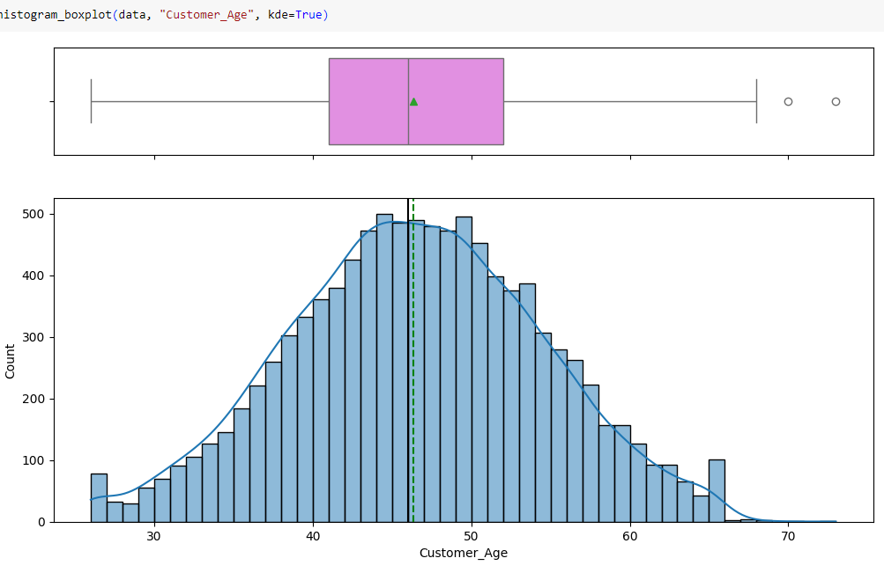
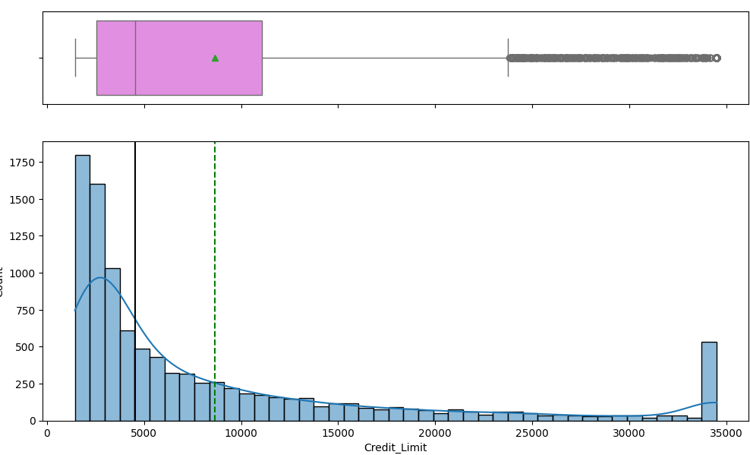
EDA Results – Univariate Analysis
Customer_age is observed to be a normal distribution with a mean/median around 46 years of age.
Credit_Limit is observed to be skewed right distribution with a median of $8,600 and significant outliers
Link to Appendix slide on data background check

Slide 7
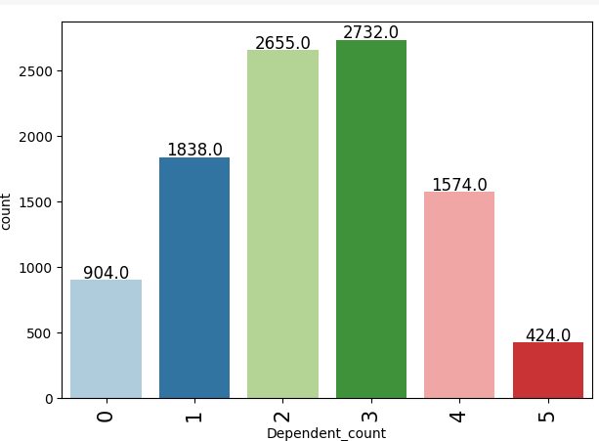
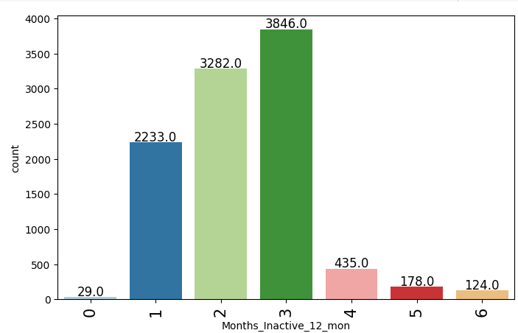
EDA Results - Univariate Analysis
Dependent_count might be an interesting variable to look at since that could potentially be correlated with higher levels of spending. It’s somewhat normally distributed with a mean/median ~ 2
Months_Inactive_12_mon is an interesting variable because only 29 out of the more than 10 accounts are 0 months. Then the number of entries increases greatly for months 1-3 and then drops down between 4-5 months. No records are inactive >6 months.
Link to Appendix slide on data background check

Slide 8
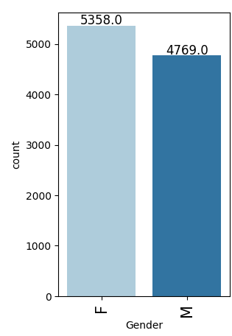
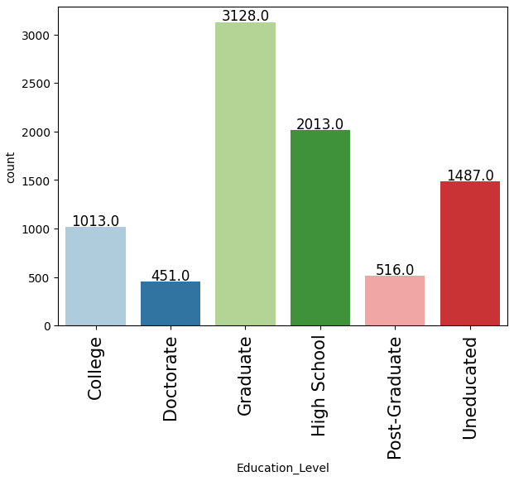
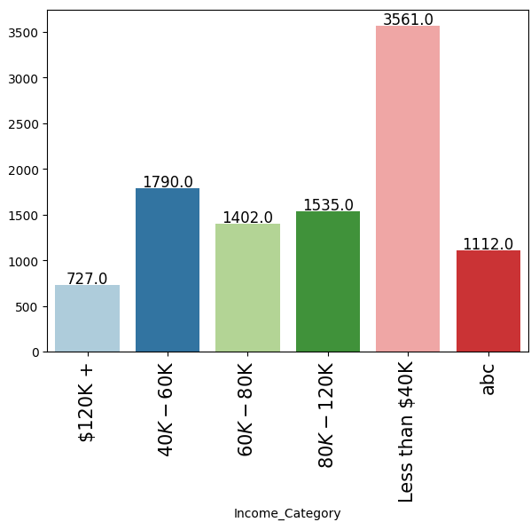
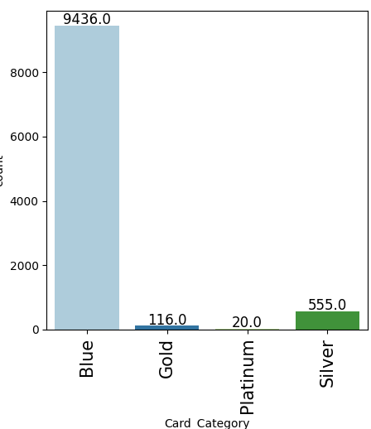
EDA Results - Univariate Analysis
In our dataset, the gender split is almost 50/50 with slightly more females than males.
Masters/Graduate degrees make up almost a 1/3 of the data set with high school and uneducated following. Note that there are still 1,519 observations with null data for education so we need to impute them before starting our model building.
The highest number of observations in income make <$40k annually. There are still records from Income_Category that need to be imputed before we can continue with our model-building.
A vast majority of card-holders have the Blue Card (lowest level). Only 20 records hold platinum status (highest level).
Link to Appendix slide on data background check

Slide 9
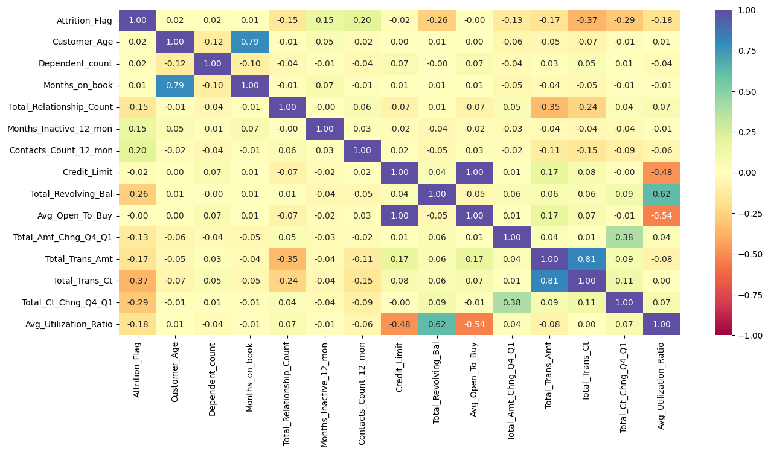
EDA Results – Bivariate Analysis – Correlation Heatmap
Among the highest correlated values, we see that Credit_Limit and Avg_Open_To_Buy have a correlation coefficient of 1 which makes sense because when you make a payment, your credit limit and amount open to buy increase by the same amount.
Months_on_book is highly correlated with age for obvious reasons. Every increase in 1 year of age is an increase of months_on_book in a positive relationship.
Avg_Utilization_Ratio is highly correlated with Total_Revolving_Balance – as money is spent, revolving balance and average utilization both increase positively.

Slide 10
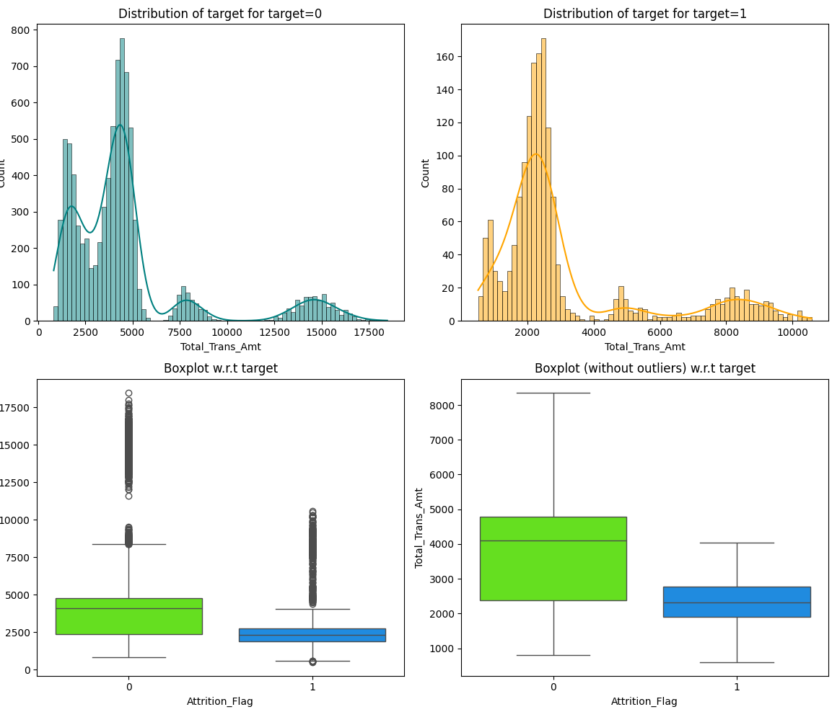
EDA Results – Bivariate Analysis
Customers who spend more annually are more likely to stay as existing customers versus those who don’t spend as much. This reinforces in the data that the more the card is utilized, the less likely the customer is to churn.

Slide 11
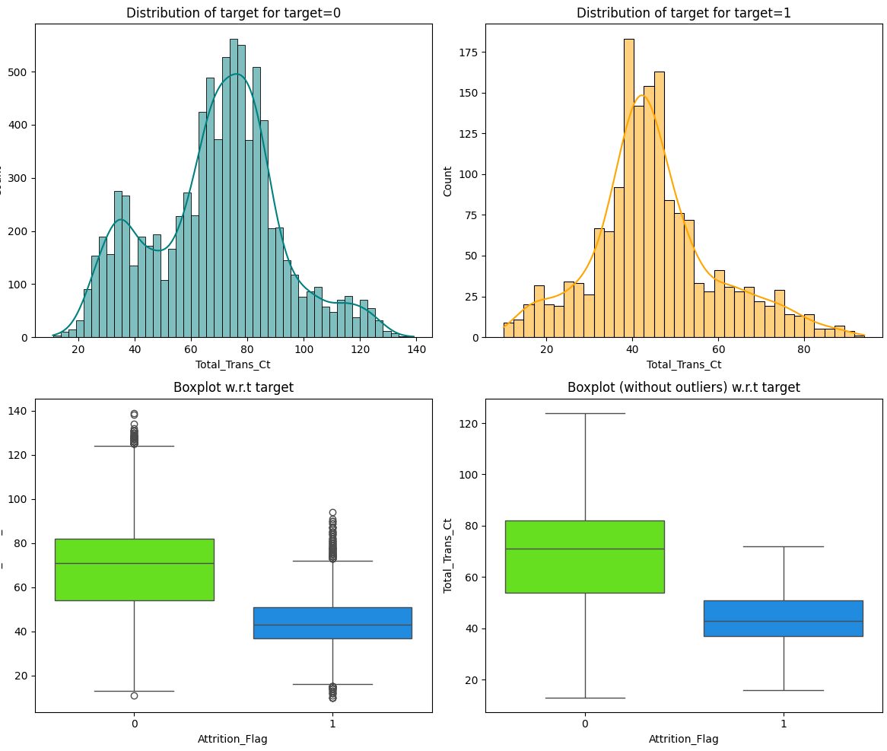
EDA Results – Bivariate Analysis
Customers with lower numbers of annual transactions are more likely to close their accounts compared to those with higher numbers of transactions. This aligns with our previous slide on higher balances – the more incentives we can provide for people to use the card and increase their balance, the less likely they to close their accounts.

Slide 12
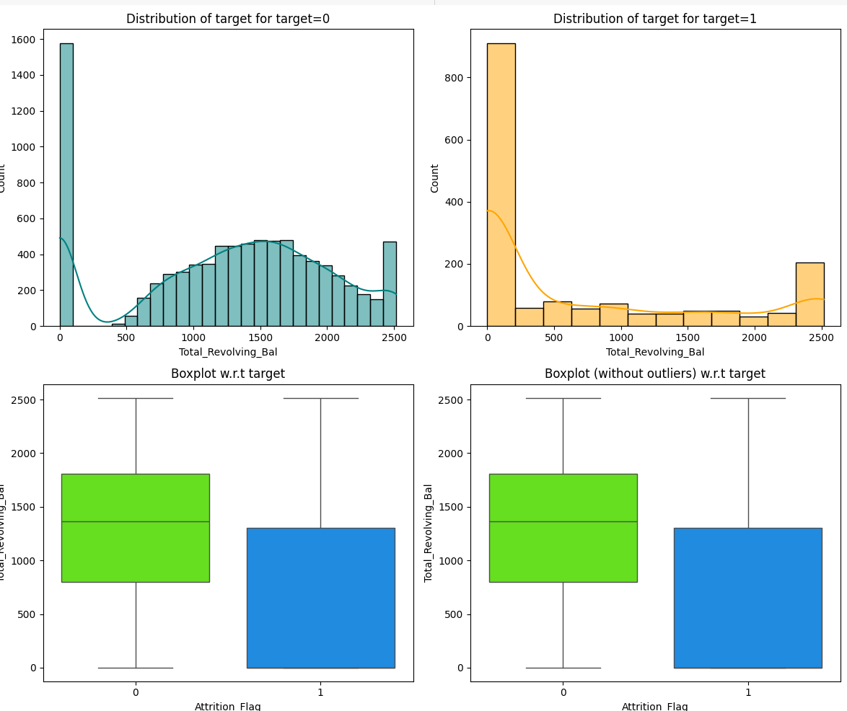
EDA Results – Bivariate Analysis
When examining the total revolving balance against the target variable of Attrition, those with lower balances were more likely to close their credit card accounts.
In both the most customers among the existing customers and those that close their accounts, most of them have zero balances. An interesting consideration is how we can lower attrition rates by offering promotions that increase balances.
Customers with higher revolving balances, meaning those who do not pay off their credit cards in full every month are more likely to remain customers.

Slide 13
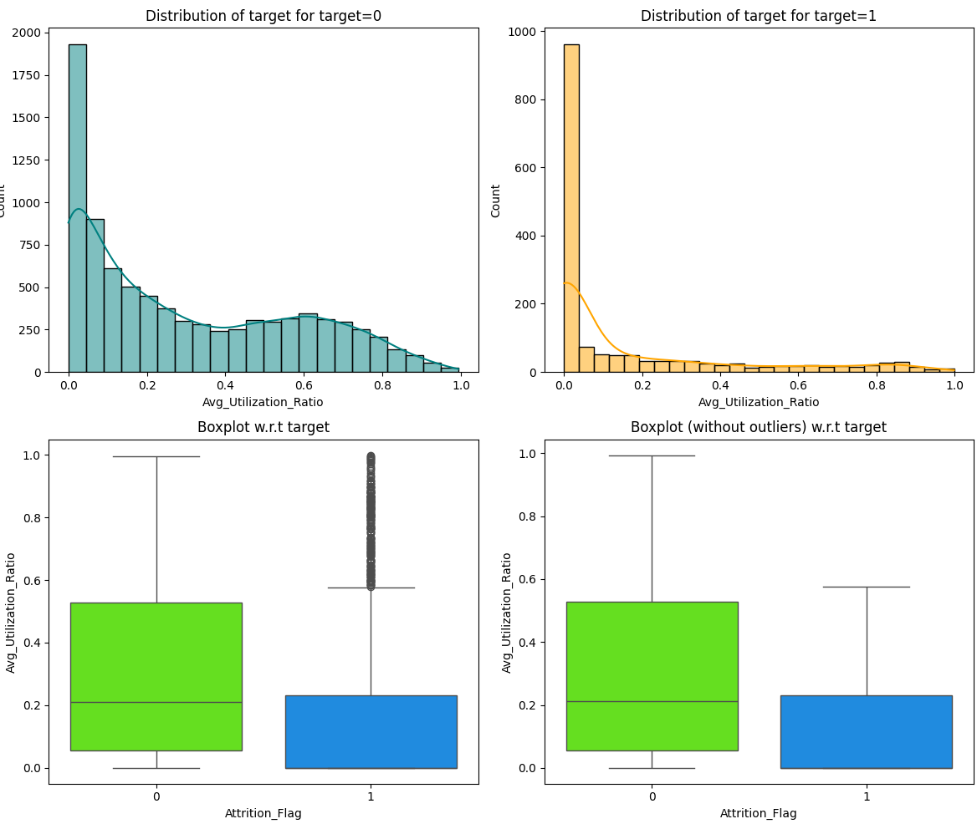
EDA Results – Bivariate Analysis
Customers with a lower average utilization ratio are more likely to churn than those with higher average utilization. This may be because they have more credit accounts open over multiple banks/accounts. This supports our observation that churn is related to no longer using the card or having other options.

Slide 14
Data Preprocessing
There were no duplicate values in the dataset.
There were a few missing values in Income_category and Marital_status. We will impute these before continuing with the model-building. There were also some strange values in the Income_Category listed as ‘abc’ that we will convert to np.na variables and then impute them using “most frequent strategy”.
There we a few outliers, most commonly in Total_Trans_Amt, Avg_Open_To_Buy and Credit_Limit. We will not treat any of these to avoid tampering with the data.
We impute data using most_frequent strategy for the columns Education_Status, Marital_Status, and Income_Category.
After being imputed, we encode Gender, Education_Level, Marital_Status, Income_Category, and Card_Category for analysis.

Slide 15
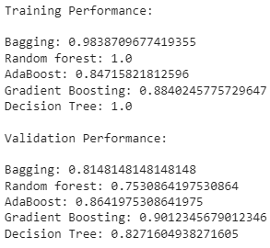
Model Performance Summary – Original Data
Bagging results in good results on the training set, but does poorly on the validation set.
Random forest is overfitted on the training set and performs poorly on the validation set.
Adaboost performance is decent on the training set and is better on the validation set
Gradient boosting shows a similar performance to Adaboost
Decision Tree is overfitting on training set and performs poorly on the validation set.
So far the boosting methods seem to do very well at recall for both training and validation set.
Link to Appendix slide on model assumptions

Slide 16
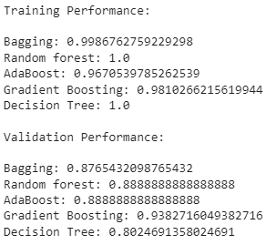
Model Performance Summary – Oversampled data
Oversampled data provides synthetic data points for the minority class to hopefully improve performance and recall performance. It does this by creating the same number in the minority class as there is in the majority class.
Random Forest, Decision Tree, and Bagging appear to be overfit on the training data and performs poorly on the validation data.
The boosting methods seemed to give great recall scores and test better on the validation set, with an advantage going to Gradient boosting
Link to Appendix slide on model assumptions

Slide 17
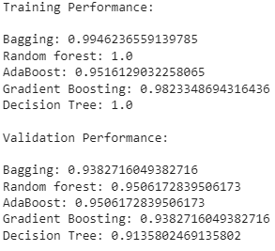
Model Performance Summary – Undersampled Data
Under sampled data balances the data set by removing majority class data from the data set until is the same sample size as the previously minority class.
Using under sampled data, all models seem to provide good performance against the validation set, with Adaboost performing the best.
Link to Appendix slide on model assumptions

Slide 18
Model Performance Summary Comparison
Original Data Oversampled Data Undersampled Data
Based on the comparisons with all the 3 different models, Adaboost and Gradient boosting seem to yield the highest recall abilities. We will use these to tune more models to make a final decision.
Link to Appendix slide on model assumptions

Slide 19
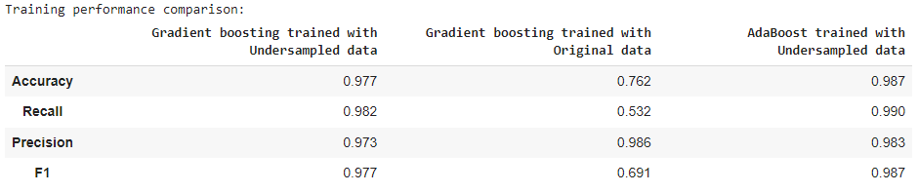
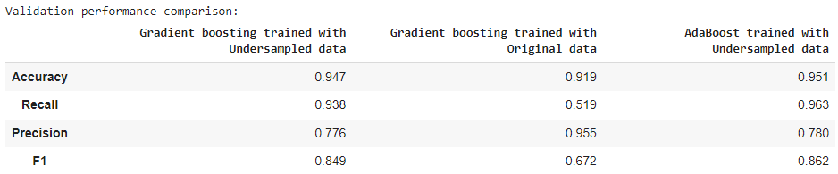
Model Performance Summary HyperParameter Tuning of Adaboost and Gradient Boost
We chose to tune the Adaboost with undersampled data, Gradient boosting with Original Data, and Gradient Boosting with Undersampled data.
According to our results, the Adaboost trained with undersampled data performs the best. It produces a .99 recall score on the training set and a .963 recall score on the validation set.
Link to Appendix slide on model assumptions

Slide 20
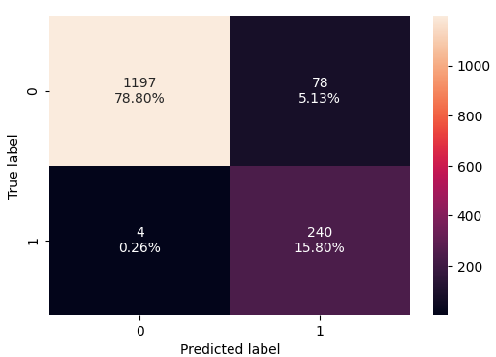

Model Performance Summary (Adaboost w/ undersample model – test set)
Here are the performance results for the Adaboost with undersampling. It performs even better on the unseen test set than it did on the validation set, producing a recall score of .984. There were only 4 observations that were incorrectly classified as false negatives.
Link to Appendix slide on model assumptions

Slide 21
Feature Importance (AdaBoost w/ undersampled

Slide 22
APPENDIX

